Slide 1
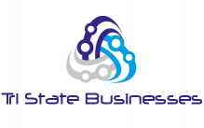
Tri State Businesses (Web page creation using SQL & PHP)
MIS 630 A: Data and Knowledge Management—Spring 2015
Team 5:
Kinjal Darji, majula Fernando, rakshat puri, ugandhara yarabham

Slide 2

Overview
1. business idea
2. Entity relationship diagram
3. Scenario 1
4. Scenario 2
5. Scenario 3
6. Scenario 4
7. Web-page demo
8. References

Slide 3
1. Business Idea
OBJECTIVE
Create a directory of businesses in Tri-state area
Create the database and web pages that will support the business processes and functionalities
PROCESS
We used github to share the ideas and suggestions to draft the project requirements
Mysql workbench was used to create tables, values and run sql queries
finally we used 000webhost to create domain and webpages

Slide 4
1. Business Idea (Cont.)
MISSION STATEMENT
The purpose of TSB is to build a database which stores the local businesses data in a directory which will be accessed by the clients/customers using web application. This directory will make it easier for the clients to find the interesting businesses and will also help the businesses to be easily available and accessed by huge customer base of this directory. People can also rate a business or write a review of a business.
GOAL
The goal is to provide an ability to the local business owners(in tri states) to publish their businesses on the website/app and respond to customer reviews. At the same time, allow the customers to search for the local businesses and write the experience in form of reviews.
USERS
Local business owners and customers.

Slide 5
1. Business Idea (Cont.)
SCOPE
Provide a platform for the customers to search local businesses for their individual needs like a saloon, restaurant, pet grooming parlors etc.
Allow the customers to write reviews about their experience at a particular business
Allow the local businesses to publish their business information
Allow the businesses to respond to the reviews
Website/App to reflect all reviews of the businesses correctly that will enable the customer to decide the right place to visit
Extend training to local businesses to effectively respond to negative feedbacks from customers
Monitor and reduce fake reviews about the businesses

Slide 6
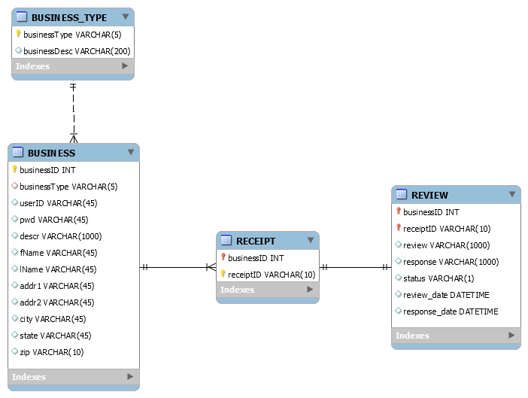
2. Entity Relationship Diagram

Slide 7
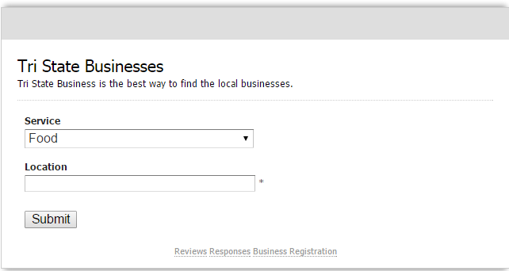
3. Scenario 1
A customer is looking for a restaurant to have lunch. He/she opens TSB.com enters the service and location. TSB displays the list of restaurants, their description, address, contact information, website address and the reviews.

Slide 8
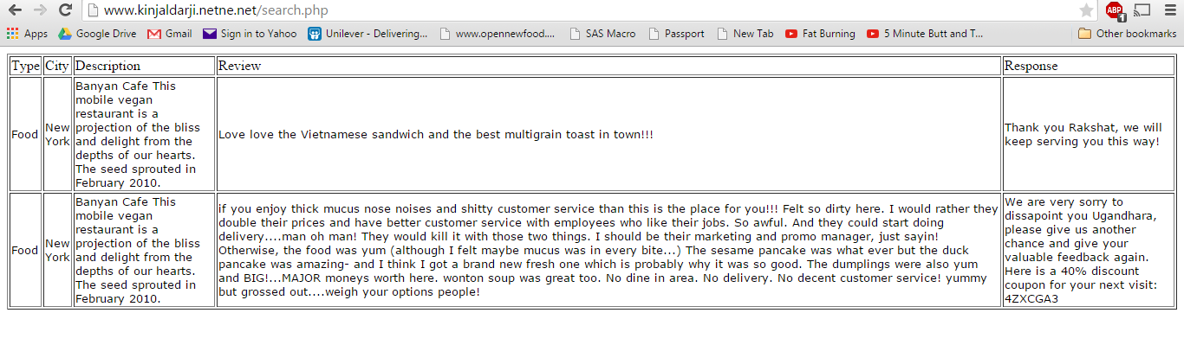
3. Scenario 1 (Cont.)
After selecting service and location, the customer clicks submit. The page displays the search results.

Slide 9
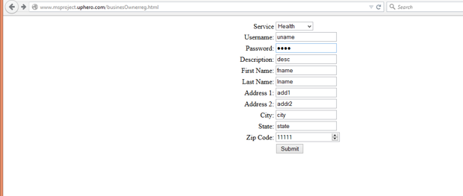
4. Scenario 2

Slide 10
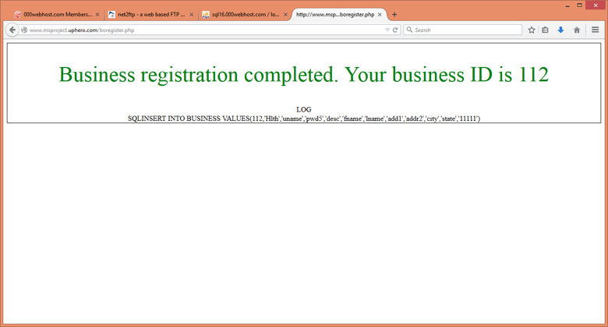
4. Scenario 2 (Cont.)

Slide 11
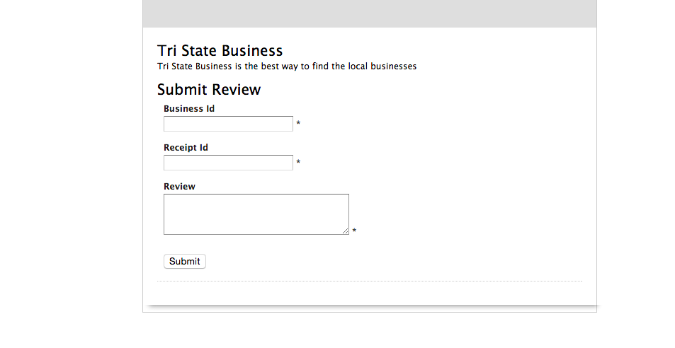
5. Scenario 3
A customer is looking to write a review. He/she opens TSB.com enters the business id and receipt id and the review .

Slide 12
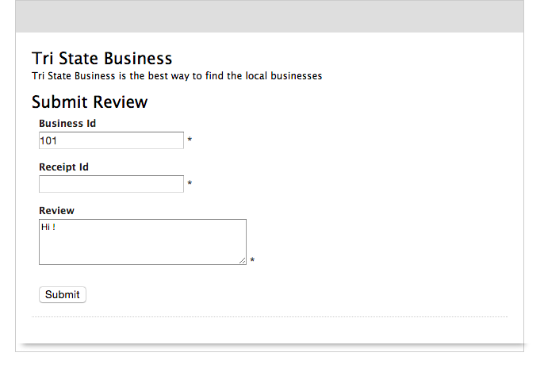
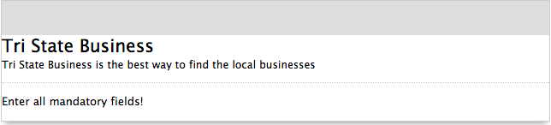
Scenario 3 - Test Case 1 – Enter all mandatory fields

Slide 13
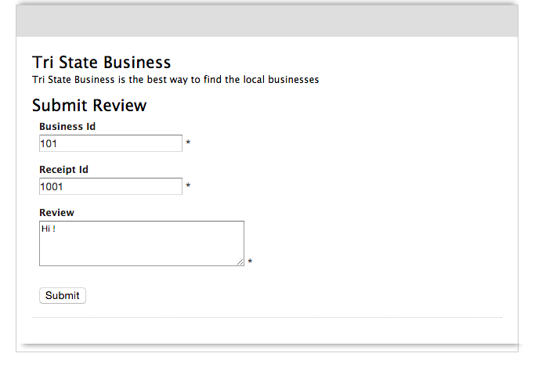
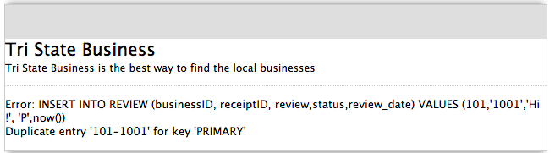
Scenario 3 – Test Case 2- Duplicate Entry

Slide 14
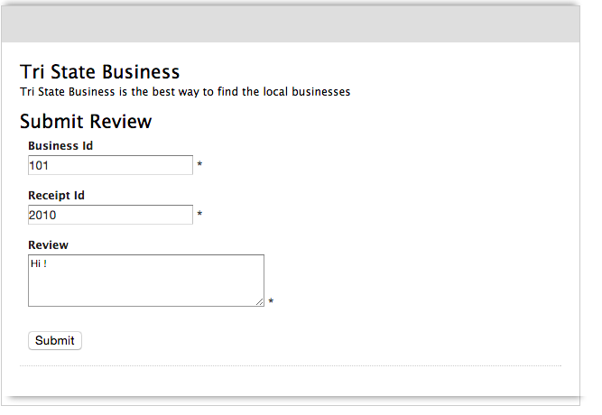
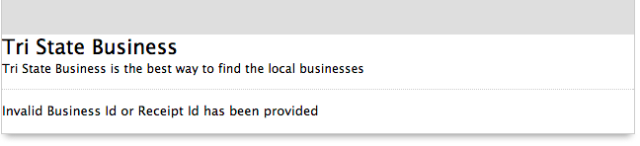
Scenario 3 – Test Case 3- Invalid ID

Slide 15
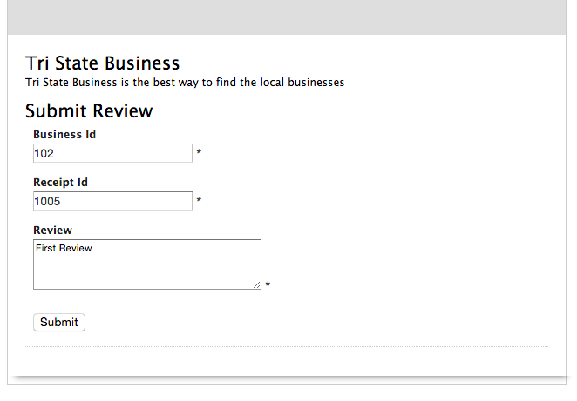
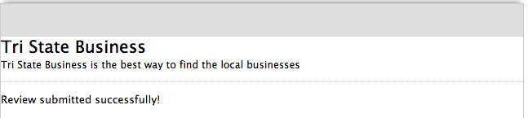
Scenario 3 – Test Case 4 – Review submitted successfully

Slide 16
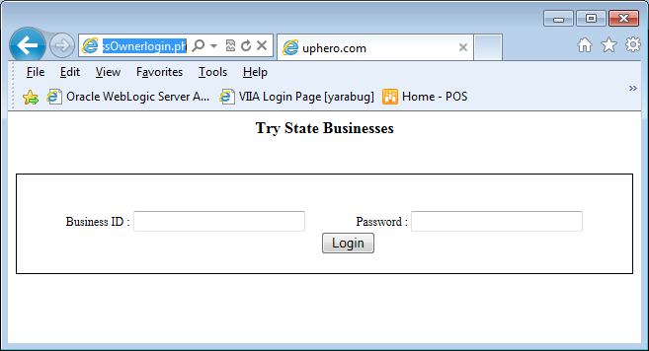
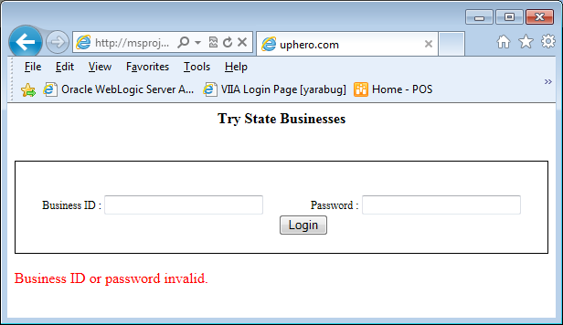
6. Scenario 4
Business Owner Login

Slide 17
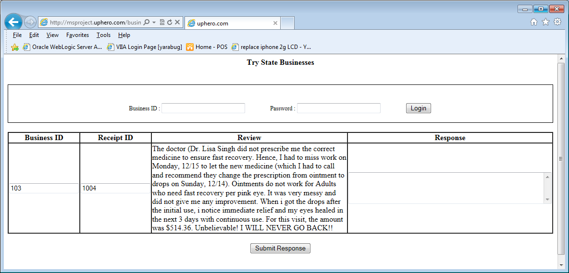
6. Scenario 4
Business Owner view review and write response

Slide 18
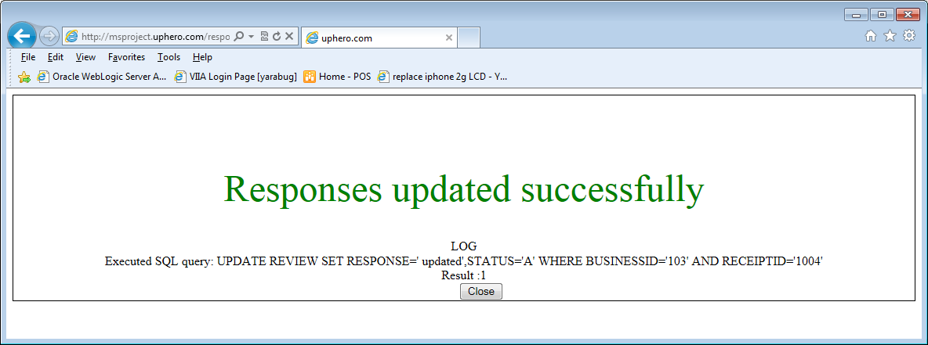
6. Scenario 4
Business owner response confirmation page

Slide 19
7. Webpage Demo
Tri-State Businesses

Slide 20
8. References
Prof Hani Safadi’s class notes and course references
Github
Mysql work bench
000webhost
www.w3schools.com

Slide 21

Thank you!

